Slide 1
Seven Hills Adaptive Drone 24-013
Team Members: Himadri Saha (CpE), Abumere Okhihan (cPE), Tejas Patil (EE), Daniel Diep (EE)
Mentor: Professor Jean-Francois Millithaler (ECE)
Sponsor Staff: Steven Kessler & Ryan beckett
Notes:
DD: We are the group assigned to the Adaptive Drone project for Seven Hills.
In our group we have Computer Engineering students: Himadri and Abu, and Electrical Engineering students: Tejas and myself Daniel.
Alongside our team members we have Professor Jean-Francois from the ECE Dept. as our mentor, as well as our staff from Seven Hills, Steven Kessler and Ryan Beckett.

Slide 2
Project Description
This project develops a hands-free system enabling quadriplegic individuals to control a photography drone independently. The system will be versatile, require minimal clinician assistance, and adapt to users without customization. It empowers users to operate drones safely and inclusively, enhancing autonomy and engagement.
Notes:
AO: read slide

Slide 3

Our client
The Seven Hills foundation is committed to promoting and providing innovative and comprehensive health services to individuals with disabilities and life challenges.
[1] “SevenHills Staff Portal Login,” Sevenhills.org, 2024. https://staff.sevenhills.org/hr (accessed Dec. 02, 2024).
‌
Notes:
DD: Seven Hills is committed to providing health services to individuals living with disabilities.
They aim to develop person-centered practices promoting empowerment and control in everyday life.
We were tasked with creating a system capable of flying a photography drone without the use of your arms.
This would allow someone with quadriplegia who enjoys photography, the ability to be able to take photos of their environment using a drone.
While we don’t have a specific client from Seven Hills, our project will be given to them to allow anyone who is in need of our product to use.

Slide 4
The Problem & Objective
People with physical disabilities such as quadriplegia have difficulties interacting with the environment. It is desired to have an adaptive photography drone controller that will provide that experience without requiring the use of limbs.
The objective is to create a set of controls for a photography drone that a person with physical disabilities can use by May 2025.
Notes:
AO: script
Read slide

Slide 5
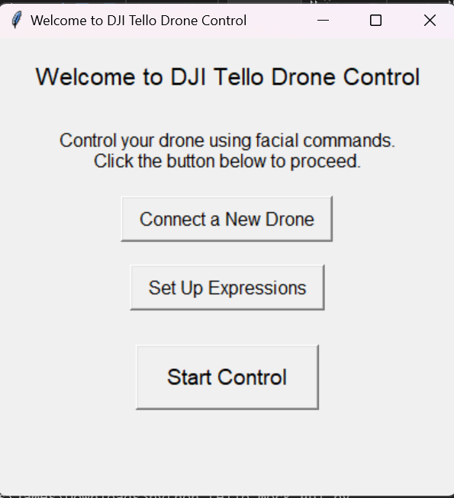
Proposed Solution Overview
To design a PC based application to track facial movements to operate the drone
The system will utilize machine learning algorithms, ensuring precise and responsive drone control tailored to the user's needs.
Notes:
AO: read slide
-Develop a PC-based application for drone control using facial movement tracking.
-Enables users to control the drone without using their hands
- Utilizes machine learning algorithms to analyze facial movements.
- This ensures precise and smooth drone operation.

Slide 6
Face detection module Overview
Detect 11 face expressions
Output a corresponding symbol for the drone control module
Setup phase to calibrate detected facial expressions
Live phase to detect user expressions frame by frame
User feedback for corresponding drone commands
Warnings for extreme camera conditions
Expressions to be tested with Seven Hills for user comfort
Notes:
HS:
The major part of the application is the face detection module
The main function of this module is to detect 11 distinct facial expressions: 8 control, 2 photography, 1 multi-purpose, and output a symbol (A-K) that will be used to control the drone
* In the app, there will be a setup phase to calibrate expressions and a live phase to control the drone
* Warning prompts will also be put in place for problematic camera conditions such as extreme lighting and camera movement. These could impact the drone's safety, so the drones “return to home” command will be sent
The facial expressions here will be tested and verified with Seven Hills for user comfort

Slide 7
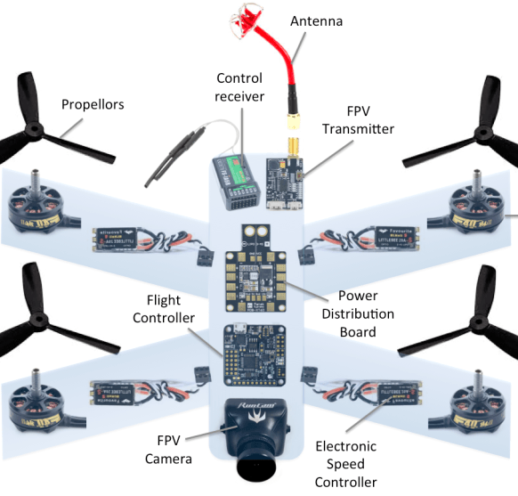
General Drone Systems
The drone is controlled through flight controls
Everything else remains the same which is ideal for the project
A new "remote" should connect to the control receiver
[2] Drone layout and quadcopter layout. (n.d.). Pinterest. Retrieved December 6, 2024, from https://es.pinterest.com/pin/519391769529211443/
Notes:
TP:
-As seen here in this picture, there are many different components for the physical drones from the propellers to the FPV camera.
-However, the one major component of the drone that controls everything is the flight controls which send signals to the other parts through connection between the control receiver and a remote.
-This means we don't have to make a new drone but rather we can change the inputs of the flight controller from a "new" remote.
- So when using a new "remote" it should connect with the control receiver so that the facial inputs can let the flight controller pilot the drone without a traditional remote

Slide 8
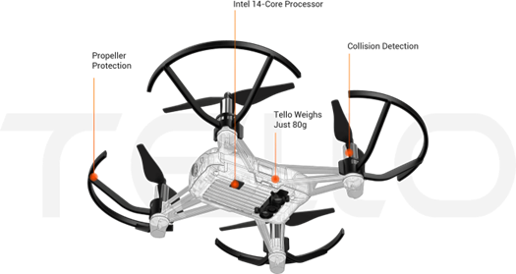
DJI Tello
Photography drone that works through Wi-Fi connection
Built in “SDK” (command set in flight controls)
djitellopy
self.drone = tello.Tello()
self.input_frame.bind('<KeyPress-w>',
lambda event: start_flying(event, 'upward', self.drone, self.drone.speed))
self.input_frame.bind('<KeyRelease-w>', lambda event: stop_flying(event, self.drone))
self.drone.connect()
self.drone.streamon()
Library
Connection
Controls
Video
[3]“SDK 2.0 User Guide 2,” 2018 (accessed Dec. 06, 2024)
Notes:
DD: Our project works with the DJI Tello photography drone.
This drone is easy to use because it utilizes a Wi-Fi connection and has a built in Software development kit or SDK.
The SDK is the command set that’s built into the flight controls.
Basically, the Tello drone has an online library called the “djitellopy” that you can pull commands from to control the drone using programming.

Slide 9
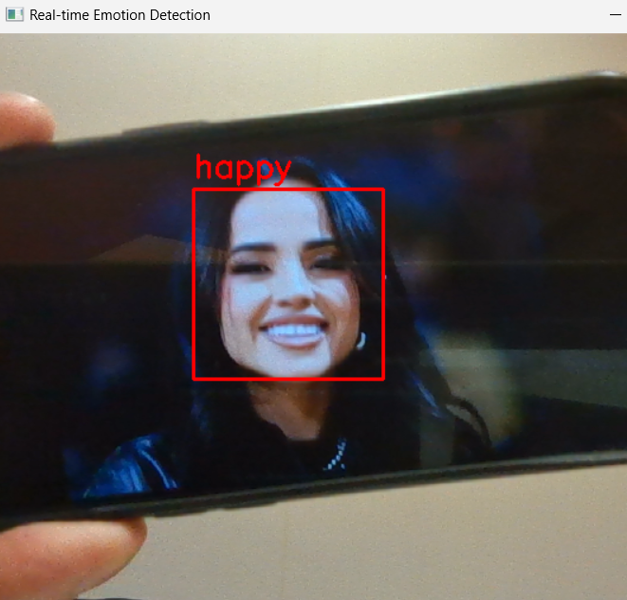
Facial Detection methods with OpenCV
OpenCV: A powerful library for computer vision
Pretrained Detection Model
Compares each frame to training data
Detects facial features and relative distances
Focus on Range of Interest (ROI) box
Functions for visualization
[4] K. Richardson, “Becky G Fights Back Tears After ‘The Fire Inside’ Oscar Nomination,” Rolling Stone, Jan. 23, 2024. https://www.rollingstone.com/music/music-news/becky-g-the-fire-inside-oscar-nomination-response-1234952781/ (accessed Dec. 11, 2024).
Notes:
HS:
In most modern facial detection applications, OpenCV us used
OpenCV is a powerful python library that hold functions for image processing tasks like facial detection
It “knows” what facial features look like based on training data
* To detect a face, sections of the webcam image will be overlayed over the pre learned data to detect facial features
The distances of detected facial features will then be calculated and compared to the pre learned data
If there are enough similarities, then a face is detected, and a ROI box is drawn around the face to be focused on
* OpenCV has functions to do all these parts as well as output text over a webcam making it easier to visualize the process
Here, an emotion recognition system detects that the user is happy using this process

Slide 10
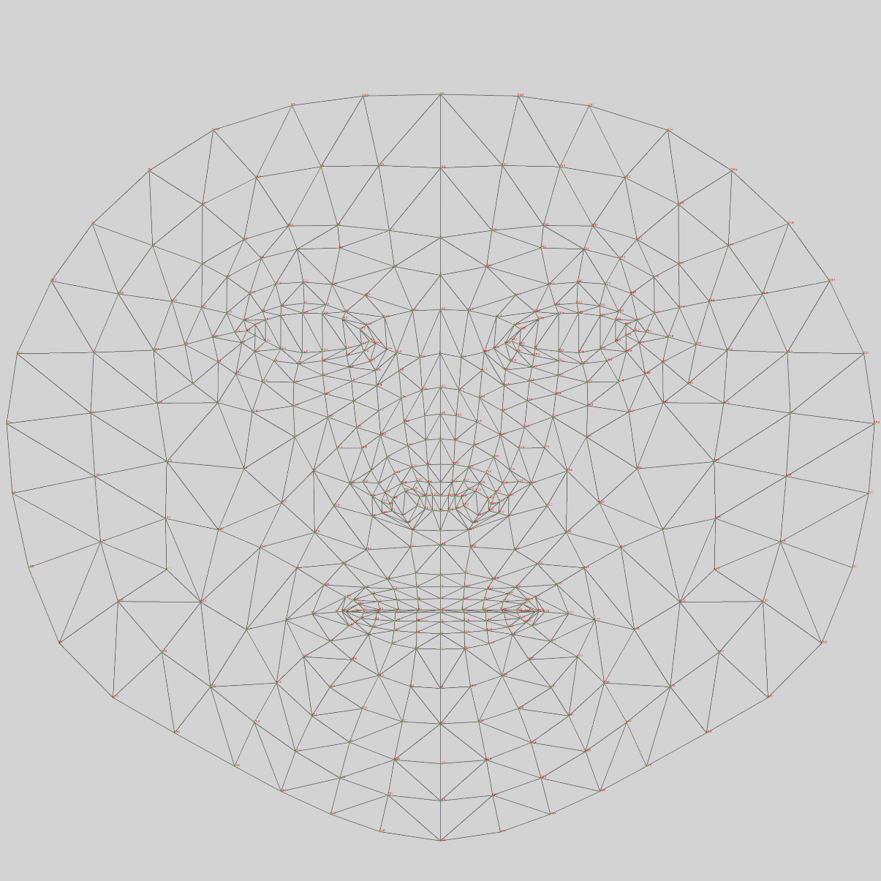
Analyzing facial features with MediaPipe
MediaPipe: A framework for detailed facial analysis
Facial landmark mesh of 486 nodes
Efficient live adjustments: updating landmarks only when needed
‌
[5] “Mediapipe facemesh vertices mapping,” Stack Overflow. https://stackoverflow.com/questions/69858216/mediapipe-facemesh-vertices-mapping
‌
Notes:
HS:
Now that the users face can be detected and tracked in a system, MediaPipe is used to analyze the finer details of the user's face
* MediaPipe is another library that has functions for this. It also overlays a mesh of 486 landmarks used for analysis
* This algorithm was chosen because it is extremely efficient, only updating landmarks that changed from the last frame
This is different from other algorithms we researched as they used less landmarks but recalculated positions regardless of if they moved or not

Slide 11

Benefits & Deliverables
Hands-free operation for users with physical disabilities
Personalized facial movement commands
PC-based application for easy setup
Intuitive controls for minimal user training
An application that houses the facial detection software
DJI Tello photography drone
Autodesk Instructables guide
[6] Instructables, “Instructables - How to make anything,” Instructables.com, 2019. https://www.instructables.com/ (accessed Dec. 02, 2024).
Notes:
AO:
Using Face detection tech removes the need for physical interaction with the system
While an assistant will be required for the set up, the user will have full control of the drone after
Because everyone's face structure is different, the system allows for users to customize the facial movements to their own comfort
Using a PC application allows a wide variety of users to use this product, and mobile applications can have issues with compatibility
Application will have prompts to allow user to quickly learn and use the system, reducing cognitive load
* DD: For deliverables, we will be giving Seven Hills an application that houses the facial detection software, we will be giving the Tello drone, and we will be making an Autodesk Instructables guide for the proper setup and operation and we’ll make sure the guide is clear and concise to ensure accessibility for all users.

Slide 12
Application Process
Homepage
Main control Interface
Facial Tracking
Camera Feed
Setting
Drone Movement Mapping
Calibration
Homepage: provides buttons for user to control drone
Main Control Interface: Facial Tracking and Camera Feed
Setting: Tracking of the Drone Movement and Video Calibration
Notes:
AO:
Homepage:
-Central hub for navigation.
-Includes buttons for accessing various sections of the application.
Main Control Interface:
-Facial Tracking: Enables the drone to dynamically follow the user's face.
-Camera Feed: Provides real-time video from the drone for situational awareness.
Settings:
-Drone Movement Mapping: Configures how the drone responds to commands and environmental conditions.
-Calibration: Ensures accuracy of video tracking and overall system performance.
Design Goals:
-Intuitive and efficient operation.
-Flexibility for customization

Slide 13
Setup Phase
Notes:
HS:
Setup:
We have a setup phase to reduce the possibility of any false positives and make the detection system more accurate
Frist the application prompts the user to make the expression
An assistant will press save once the expression is made
The distance of each landmark from the tip of the user's nose will be calculated
This ensures that not matter where the users face is on the screen, the correct expression will be detected
These are saved in python dict with their corresponding symbol

Slide 14
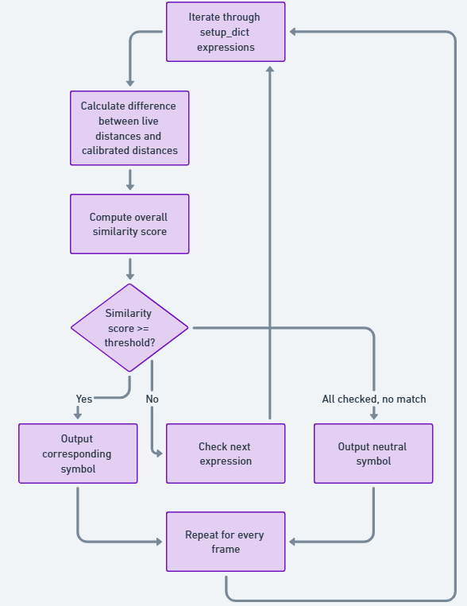
live phase
Notes:
HS:
Live:
- This is the phase where the user will get to control the drone
For every frame of the video capture feed:
The relative distance of all landmarks will be calculated, outputted as an array
This will be compared to all saved expressions using a similarity score calculator
Each saved expression has a threshold that controls how accurate the users face needs to be
If the most similar expression is above its threshold similarity score, the corresponding control symbol (B-J) will be outputted
If not, the symbol for a neutral face will be outputted (A)

Slide 15
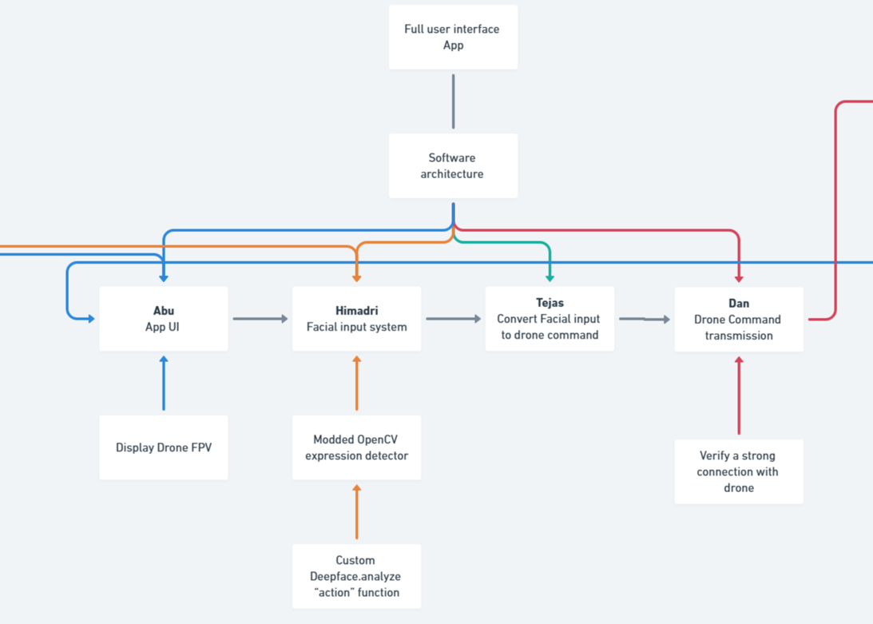
What's been done
An initial design and experimental version of facial tracking module
Able to use the SDK for the DJI Tello
Software architecture documentation for the project
Notes:
TP:
- So far what has been done, as said previously by Himadri, a facial tracking module using OpenCV is designed and experimental right now where it will recognize certain expressions to make an output.
-In addition, we were able to control the DJI Tello drone through the SDK command set with inputs like keys on a keyboard.
-Lastly we have the software architecture of each step to accomplish for the project.

Slide 16
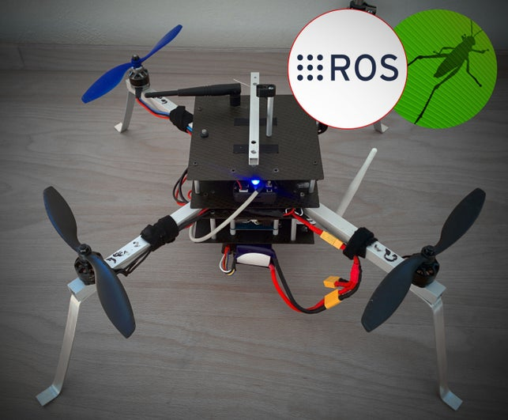
Next Steps
Integration of all modules into a working application
Video feed transmission capabilities from the drone to the app
Possible system that can use other drones' receivers/Linking controls
[7] Instructables, “Control a Pixhawk Drone Using ROS and Grasshopper,” Instructables, Aug. 25, 2016. Accessed: Dec. 09, 2024. [Online]. Available: https://www.instructables.com/Control-a-Pixhawk-Drone-Using-ROS-and-Grasshopper/
Notes:
TP:
-Following the software architecture, our next step once we can finalize the facial tracking inputs for the drone is to integrate the flight controls and those inputs together into an application that Abu has mentioned previously.
-Then we can begin to transmit video feed from the drone directly to the app so a person can take pictures and see what the drone sees. ---We are thinking of possibly making the system work with other drones through their control receivers but some challenges arise where drones have their own flight controls that are unique to that model or have their own encryption

Slide 17
Summary and Acknowledgements
Face detection module that allows a user to control a DJI Tello drone using only facial movements
Thank you to our mentor, Professor Jean-Francois Millithaler (ECE), Professor Sabato (ME), Professor Cabrera (CS), and our sponsor Seven Hills
Notes:
HS: In summary we are creating a face detection module that can detect a user’s facial movements to allow them to control a Tello drone.
DD: We wanted to acknowledge our mentor, Professor Jean-Francois, for guiding us through the work on this project.
A thank you to Professor Sabato for providing the Tello drone to test with and Professor Cabrera for providing us some software resources.
Also a big thank you to Steven Kessler and Ryan Beckett, who are our sponsor staff from Seven Hills. Thank you.

